Slide 1
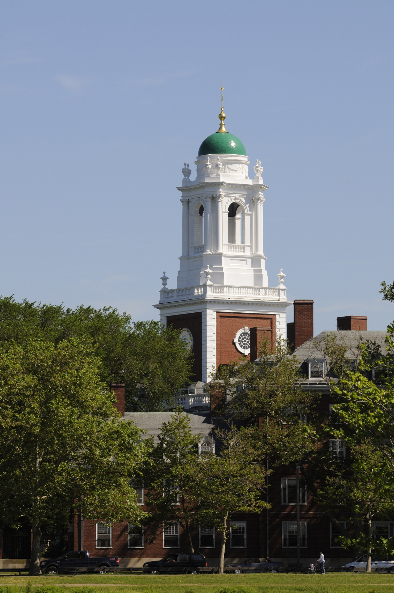
CAMPUS SERVICES
Fulfilling our Mission

Slide 2
What is Campus Services?
Twelve business units and a shared finance and administration group that support Harvard’s mission of teaching and research by providing the best possible service.
Energy &
Facilities
Dining
Housing
Real Estate
Shared Services:
Finance
Admin
HR
IT
Comms
Transportation
Environmental Health &
Safety
Faculty Club
Office for
Sustainability
Capital Projects
Global Support
Services
International
Office
Common
Spaces
Notes:
What is Campus Services? We are twelve business units, that provide a wide-range of non-academic services to the University community. Supporting those business units, we also have a shared finance and administration group. But while these groups do many different things, we should learn to emphasize what we have in common over what makes us different. To be effective University stewards, we need to keep breaking down the silos that divide us and become more integrated as Campus Services
In particular we all share one common mission.

Slide 3
OUR MISSION
To advance Harvard University’s mission of teaching and research,
we partner to provide stewardship, strategies, and services that create exceptional community experiences.
Notes:
Our mission: To advance Harvard University’s mission of teaching and research, we partner to provide stewardship, strategies, and services that create exceptional community experiences.

Slide 4
How do we fulfill our mission?
We act in the University’s best interest
We are invested in each other’s success
We build partnerships based on trust and transparency
We commit to being a learning organization
We value diverse perspectives to drive a culture of innovation
We listen to our partners to drive success and solve challenges
Notes:
We’re also bound together by a series of guiding principles that employees should look towards to guide their work on a day-to-day basis to help create exceptional community experiences. Be sure to always:
We act in the University’s best interest
We are invested in each other’s success
We build partnerships based on trust and transparency
We commit to being a learning organization
We value diverse perspectives to drive a culture of innovation
We listen to our partners to drive success and solve challenges

Slide 5
What is our Vision of Success?
Vision
Energy &
Facilities
Dining
Housing
Real Estate
Shared Services:
Finance
Admin
HR
IT
Comms
Transportation
Environmental Health &
Safety
Faculty Club
Office for
Sustainability
Mission
Values
Capital Projects
Global Support
Services
International
Office
Common
Spaces
Guiding Principles
Notes:
What is our ultimate vision of success? Broadly speaking it is an integrated and diverse Campus Services delivering exceptional community experiences.
We are integrated and bound together by a common mission, common guiding principles, and common goals.

